Slide 1
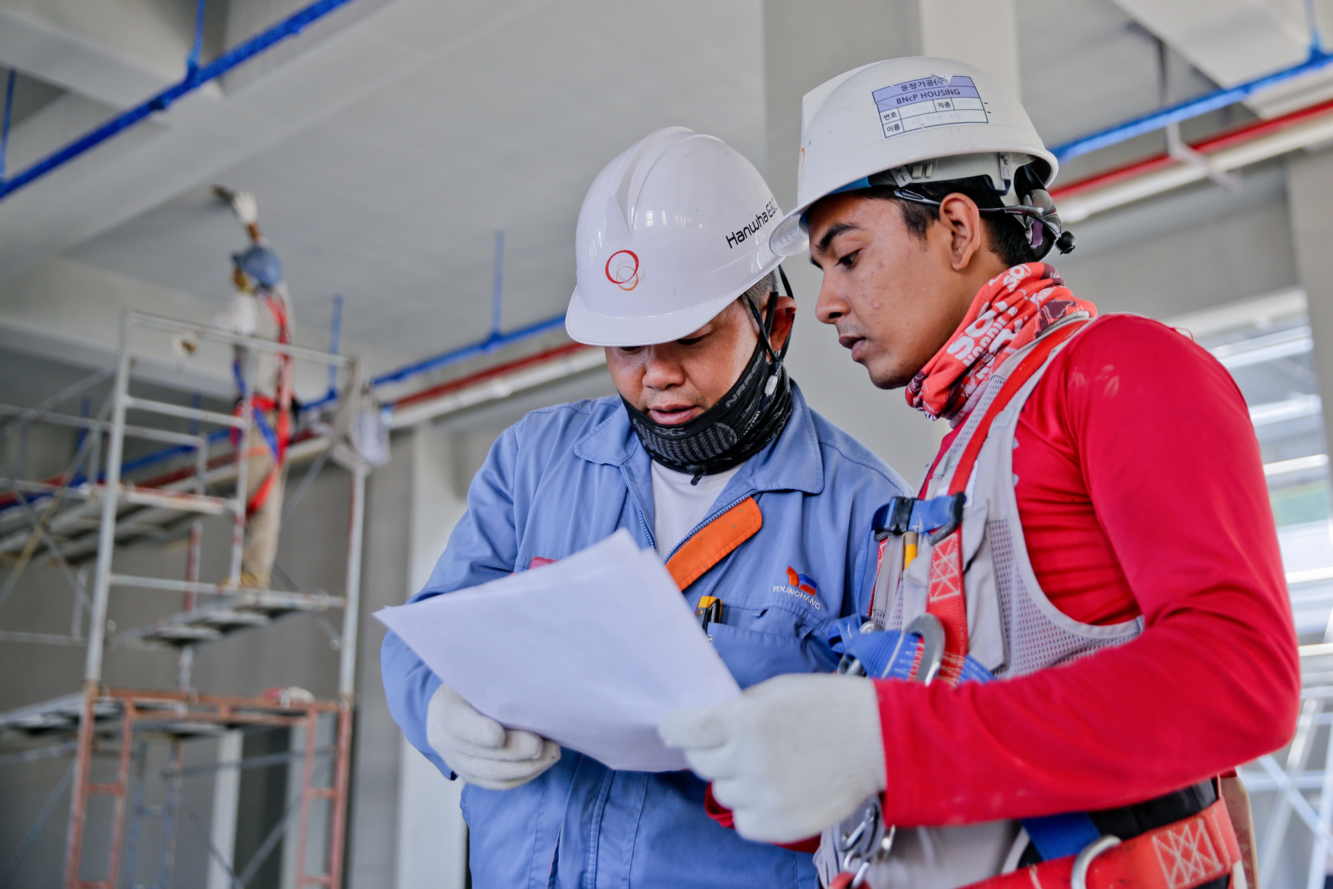
TEAM PROJECT 1
CATTLE HANDLING FACILITY IMPROVEMENT
PROJECT MANAGEMENT

Slide 2
GROUP C
Meet Our Great Team
VANHORN, ANDREA
RASHED, MOHAMMED
BALMACEDA, RODRIGO
MUTUNGI, VINCENT

Slide 3
PROJECT OVERVIEW
Description
Design and construct a modern cattle handling facility to enhance efficiency and safety.
Key Objectives:
Enhance efficiency in cattle handling operations
Improve safety for handlers and livestock
Ensure compliance with industry standards
Complete within budget ($119,650) and timeline (May 1 - July 2, 2025)
Satisfy stakeholder needs
Enable future scalability
Significance:
Modernizes farm operations while applying Project Management principles

Slide 4


PROJECT CHARTER HIGHLIGHTS
Project Title: Cattle Handling Facility Improvement
Project Start Date: May 1, 2025
Projected Finish Date: July 2, 2025
Budget Information: Estimated Budget $119,650
Project Manager: Andrea VanHorn
Success Criteria:
Timely Completion
Budget Adherence
Efficiency Improvement
Safety Enhancement
Standards Compliance
6. Stakeholder Approval
Project Objectives:
Enhance Efficiency
Improve Safety
Ensure Compliance
Meet Deadlines and Budget
Satisfy Stakeholders
Enable Scalability
Approach:
Design and Planning
Approval
Material Procurement
Site Preparation
Construction
6. Quality Checks

Slide 5
STAKEHOLDER MANAGEMENT
Key Stakeholders:
Project Manager: Andrea VanHorn
Architect: Mohammed Rashed
Foreman: Rodrigo Balmaceda
Farm Manager: Vincent Mutungi
Construction Companies: Davenport and Gillmore
Owner-Operators: Corey & Andrea VanHorn
Engagement Strategy:
Regular updates via meetings, emails, and reports (per Communication Plan)

Slide 6

SCOPE MANAGEMENT
Components:
Scope Description:
Materials
Construction Elements
Equipment & Machinery
Labor Requirements
Stakeholder Engagement
Safety Considerations
This project includes the planning, design, procurement, and construction of a fully operational corral system
Key Deliverables:
Fully functional corral system
Site preparation report
Material procurement report
Safety compliance checklist
Final inspection and approval
Exclusions:
The project will stay within its predefined area, without acquiring additional land or modifying non-corral farm structures. It will not include automation, electronic cattle management systems, or non-functional landscaping enhancements.
Project Constraints:
Assumptions:
Timeframe: within 2 months
Budget: $119,650
Resource Availability
The project assumes favorable weather for construction, timely regulatory approvals, smooth material procurement, and prompt stakeholder feedback to prevent delays.

Slide 7
TEAM CONTRACT
Ensures accountability, collaboration, and alignment with project goals
Team Members & Roles:
Andrea VanHorn: Project Manager (Planning, oversight)
Mohammed Rashed: Architect (Design creation)
Rodrigo Balmaceda: Foreman (Material procurement)
Vincent Mutungi: Farm Manager (Safety & functionality review)
Davenport Construction: Primary Contractor (Construction execution)
Gillmore Construction: Subcontractor (Excavation)
Corey & Andrea VanHorn: Owner-Operators (Define needs, feedback)
Key Expectations:
Open & timely communication
Adherence to deadlines and quality standards
Safety compliance with industry practices
Meeting Schedule:
Weekly Progress Meetings: Fridays at 10 AM
Risk Management and Contingency Planning:
To mitigate risks, the project will adjust schedules for weather delays, secure alternative suppliers for material shortages, and enforce safety protocols through briefings and protective measures.

Slide 8
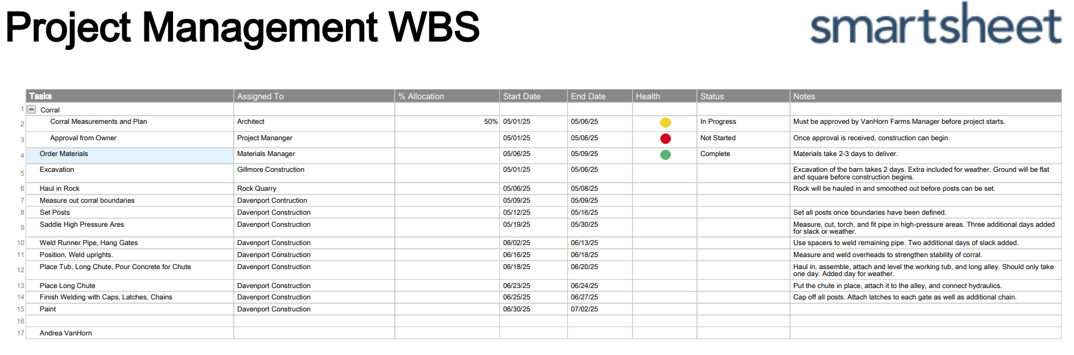
WORK BREAKDOWN STRUCTURE (WBS)
Breaks project into manageable tasks for scheduling and accountability
Timeline: May 1, 2025 - July 2, 2025
Key tasks: Design & Planning (Architect, May 1-6), Approval (Project Manager, May 1-6), Material Procurement (Foreman, May 6-9), Site Preparation (Gillmore Construction, May 1-6).

Slide 9


COMMUNICATION PLAN
Weekly team meetings: Fridays at 10 AM
Daily status reports for critical tasks
Escalation procedures based on issue priority
If the Communication Plan requires any revision, it will require approval from Corey & Andrea VanHorn. Corey and Andrea VanHorn will approve and finalize any amendments to improve and facilitate communication.

Slide 10
Roles & Responsibilities
Project Manager: Leads risk management, mitigation, and project oversight.
Architect: Ensures design compliance and safety, identifies design risks.
Foreman: Manages procurement risks and supply chain issues.
Construction Team: Reports site risks and implements mitigation measures.
Supplier: Ensures material availability and reports potential delays.
RISK MANAGEMENT PLAN
Approach:
Qualitative assessment using a risk matrix to identify, assess, and prioritize risks.
Process:
Identify risks via brainstorming and stakeholder input.
Assess risks with a scoring system.
Prioritize based on combined risk score.
Track risks using a risk matrix and register.
Budget & Schedule:
Budget: $119,650 with 10% contingency ($11,965) for high-priority risks.
Schedule: Risk monitoring integrated from May 1 – July 2, 2025, with key checkpoints (May 6, June 10, June 27).
Risk Categories
Very Unlikely: Equipment breakdown (low impact).
Likely: Weather delays (medium impact).
Very Likely: Material price fluctuations (high impact).

Slide 11
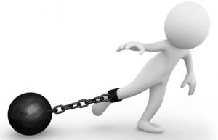
3. Resource Availability
Description: Limited team members and materials.
Impact: Restricts flexibility, requiring efficient resource use.
4. Regulatory & Compliance
Description: Must meet livestock handling and worker safety regulations.
Impact: Ensures compliance but may increase costs and time.
Constraints List
7. Technology Constraints
Description: Uses standard construction tools and methods.
Impact: Ensures feasibility but limits advanced solutions.
8. Risk Management
Description: Risks must be handled within predefined mitigation plans.
Impact: Requires proactive planning to balance quality, time, and budget.
1. Budget Limitations
Description: Fixed budget of $119,650, with no extra funding unless approved.
Impact: Requires strict cost control and prioritization of essential expenses.
2. Time Constraints
Description: Project runs from May 1 to July 2, 2025, with no extensions.
Impact: No room for delays; contingency planning is essential.
5. Stakeholder Expectations
Description: Must align with farm owner’s and instructor’s requirements.
Impact: Limits creative freedom; requires regular feedback.
6. Scope Restrictions
Description: Focused on corral, chutes, and tub; expansions require approval.
Impact: Prevents scope creep but needs structured change management.
9. External Vendor Dependencies
Description: Relies on vendors for materials and labor.
Impact: Requires strong coordination and backup plans.
10. Data Security & Confidentiality
Description: Documentation must be kept confidential.
Impact: Protects sensitive data but adds administrative oversight.

Slide 12
LESSONS LEARNED & FUTURE IMPROVEMENTS
✅ Project Successes
Efficiency: Cattle handling time reduced by 30%.
Safety: Incident reports down by 40%.
Compliance: Met all regulations, avoiding fines.
Stakeholder Engagement: 95% satisfaction from farm owners/workers.
Budget Management: Completed 5% under budget.
Sustainability: Eco-friendly materials cut carbon footprint by 20%.
⚠️ Challenges & Solutions
Construction Delays: Recovered time with pre-assembled materials.
Material Procurement Issues: Added backup suppliers & pre-ordered critical materials.
Worker Training Needs: Early training sessions improved adoption.
📌 Key Takeaways for Future Projects
Time Buffering: Add 15% contingency for delays.
Supplier Diversification: Engage 3+ suppliers for critical materials.
Early Stakeholder Involvement: Maintain user engagement to ensure adoption.
Technology Integration: Explore smart tracking for efficiency gains.
🚀 Future Recommendations
3D Modeling & Simulations to identify design flaws early.
RFID Tracking for enhanced livestock monitoring.
Renewable Energy solutions to expand sustainability efforts.
Performance KPIs to track improvements over six months.

Slide 13

THANK YOU !
CREATED BY GROUP C

